Slide 1

DEPARTMENT OF COMPUTER SCIENCE & ENGINEERING
SCHOOL OF COMPUTING
1156CS701- MAJOR PROJECT(INHOUSE)
WINTER SEMESTER 2023-2024
REVIEW - II
“Block chain Land And Flat Registry Platform-Reducing Frauds and Delays”
SUPERVISED BY
Dr. ARUNA
PRESENTED BY
1. K DAYASAGARAN (12056) (20UECS0395)
2. P ARULSIVA (17237) (20UECS0674)
3. M RUDHRA KUMAR (12071) (20UECS0546)

Slide 2
AGENDA
ABSTRACT
OBJECTIVE
INTRODUCTION
LITERATURE REVIEW (SOFT COPY OF PAPERS TO BE LINKED AS HYPERLINK)
DESIGN AND METHODOLOGIES
IMPLEMENTATION
TESTING
INPUT AND OUTPUT
INCLUDE DEMO VIDEO-1 (Till REVEW-1)
INCLUDE DEMO VIDEO-2(Complete Implementation of Project)
CONCLUSION
WEB REFERENCES LINK (TILL REVIEW DATE ALL LINKS TO BE INCLUDED DAY WISE)
PLAGIARISM REPORT OF PPT
REFERENCES

Slide 3
ABSTRACT
In the traditional Land and House Registration system practiced in India, there exists a middle man (broker) who establishes a contact between the buyer and seller, for instance if an individual wants to buy or sell a property ,the broker will create and assemble all the obligatory physical documents with regards to an agreement as a proof of property. Brokers will ensure that the land & house property would be registered by an authorised government office where all the attributes are noted down in a ledger and thereafter the whole transaction and purchasement between the two parties takes place. In this scenario ,there are chances of losing or tampering of the documents as anyone with certain powers can access or alter the papers easily which in turn threatens this concrete proof of land & house. Thus, this type of system as compared to our proposed system in which we make use of a smart contract to deal with the assets and transactions among the participants, is relatively time consuming, less secure and unsynchronized where activities including corruption and fraudulence might be associated during the execution of the required process. With an amalgam of inspection and analysis regarding the old accustomed way and considering that Innovative Resistance has an increased transparency and integrity maintenance along with the portability factor, we put forward a Innovative Resistance based land&house registration system which provides a transparent, secured and decentralised method for execution of transactions between the participants by employing the concept of hyper ledger. Index Terms Innovative Resistance Land&House, Hyper ledger, land&house registration.

Slide 4
OBJECTIVES
Aim of the project
In this system, users would register on the portal and can take up the role of a buyer or seller accordingly. The seller needs to upload all requisite details whereas the buyer can then buy the House & lands on the portal that are verified by the smart contract. Further users can get deeds digitally which will be uploaded as a new block in the chain. In this way this proposed system does not involve any middleman and all transactions are directly dealt between the buyer and the seller.
scope of the project
The Land & House registration system incorporating Innovative Resistance using Innovative Resistance provides features like registration of owner and land & House by uploading mandatory verified documents. After verification of the owner/land using smart contract using smart contract and consensus protocols implemented in the model , land can be put up for the sale and then assets will be visible to all the potential buyers.

Slide 5
INTRODUCTION
Block chain is an emerging platform for developing decentralised applications and data storage among the shared parties with all recorded transactions that have been executed through- out the process.
Each and every transaction in the public ledger is verified using consensus protocols involving majority of the participants of the system. As the new data is emerging blocks are created and encrypted using hashing algorithms.
Thus, the information entered once cannot be modified without consulting a legal administrator. Block chain allows one to create a ledger of events, transactions and data, generated through various IT processes with strong cryptographic guaran tees that is distributed and replicated across the network for tamper resistance, immutability and verifiability.
It is a distributed digital ledger that is open, shared, transparent and highly secured which means all the transactions or records processed are immutable and verifiable.
As the name indicates, block chain allows a block of data to grow as new blocks are appended to it, with each block containing transaction information stored in a specially designed data storage structure.

Slide 6
LITERATURE REVIEW
[1] Lina Ge , 1,2,3 Jie Wang,1,2 and Guifen Zhang1 “Survey of Consensus Algorithms for Proof of Stake in Blockchain” 2022
[2] Xiaohui Zhang , 1 Mingying Xue , 2 and Xianghua Miao 1,3 “A Consensus Algorithm Based on Risk Assessment Model for Permissioned Blockchain”2022
[3] Mladen Zrinjski 2 and Marina Peko 3 “Blockchain-Based Land Management for Sustainable Development”. 2022
[4]Mohammed Shuaib ,Noor Hafizah Hassan, Sahnius Usman, Shadab Alam , Surbhi Bhatia,Deepika Koundal,Arwa Mashat, and Assaye Belay “Identity Model for Blockchain-Based Land Registry System: A Comparison”. 2022

Slide 7
DESIGN AND METHODOLOGIES
MODULE 1
MODULE 2
MODULE 3
MODULE 4

Slide 8
MODULE 1
Impact of demonetization on housing sector
Deep impact of demonetization since its implementation i.e. from 9th November 2016 has been observed on two different segments: newly constructed property and resale property. Demonetization has less shock on the newly constructed property market and more along the resale property market. The important observation is that even though there were less real estate transactions in last six months, but there was not a high drop in the monetary value of the newly constructed property, resale property, and estate (15). Builders have gone into negotiation with a serious buyer who is eligible for home loans. This has got buyers considerable value for their money and a perfect chance to keep open on property purchased with bargaining (16). A resale property has faced a direct impact due to demonetization because cash payment took on a vast role in such events.

Slide 9
MODULE 2
Real Estate Investment Trusts (REITs)
A real estate investment trust (REIT) generally is a firm that buys and manage revenue property (Equity) or credit finances (Mortgage). REIT’s bid a number of rewards to persons who don’t have adequate capital to invest in the real estate sector but desire to have own possessions (17). REITs have opened up a perspective that will permit all investors even those with smaller budgets of a sum as Rs.2 lakh to make secure and rewarding investments into the Indian real estate sector. REIT is a procedure to create funds from stakeholders by directly investing in genuine estate properties like residential units, offices, shopping centers, hotels, warehouses, etc. Agreeing to this Act, dividends of 90 percent will be catered to an investor from the capital gains accruing from the sale of the commercial asset. It will provide diversified and safe investment opportunities with reduced risks and maximum return on investments. As per REITs investments guidelines, at least minimum 80 percent of the price of REIT’s assets are mandatory to be invested in completed projects, rent making properties and remaining 20 percent in properties under.

Slide 10
MODULE 3
Real Estate Regulatory Authority (RERA)
To safeguard homebuyers and investors in the real state segment, the parliament of India passed the principles and procedures of RERA in March 2016. This Act is obligatory for all residential and commercial projects where the land area exceeds more than 500 sq. meters or 8 apartments. Builders have to register on-going projects within three months of commencement of the Act in order to provide transparencies in a project (18). Registration applications can be declined or approved within the thirty day period from the date of application to the real estate regulatory authority. A penalty of 10 % on project cost or three years custody can be imposed on those builders who fail to enrol with real estate regulatory authority. The major benefit included in the Act is that builders have to quote rates based on carpet area (including toilets and kitchen) and not super built-up area. This will ban unaccounted money to be pumped from buyers into real estate sector as 70 % of the amount has to be deposited in the builder's bank account. All union territories and two states

Slide 11
MODULE 4
Benami Transaction Act
The Benami Transaction Act will restrict black money flow in the housing sector. The benami transaction act defines that a property is held by or transferred to a person, but has been paid by third person. Property transaction includes: (i) the transaction did with fake names (ii) unawareness about ownership of property by the owner and (iii) unable to trace person providing the consideration for the property. Instead of possessing black money in cash, the tax evader invests their gathered illegal money in buying benami properties. The whole process reduces the income generation of government adversely affecting growth and development of the country. As the taxpayer's percentage in the country is miserable, the government has failed to successfully implement its policies and schemes due to lack of resources. A strong law against benami properties is needed to have a check on corruption

Slide 12
IMPLEMENTATION
ARCHITECTURE DIAGRAM
DATA FLOW DIAGRAM
ER DIAGRAM
SEQUENCE DIAGRAM
COLLABORATION DIAGRAM

Slide 13
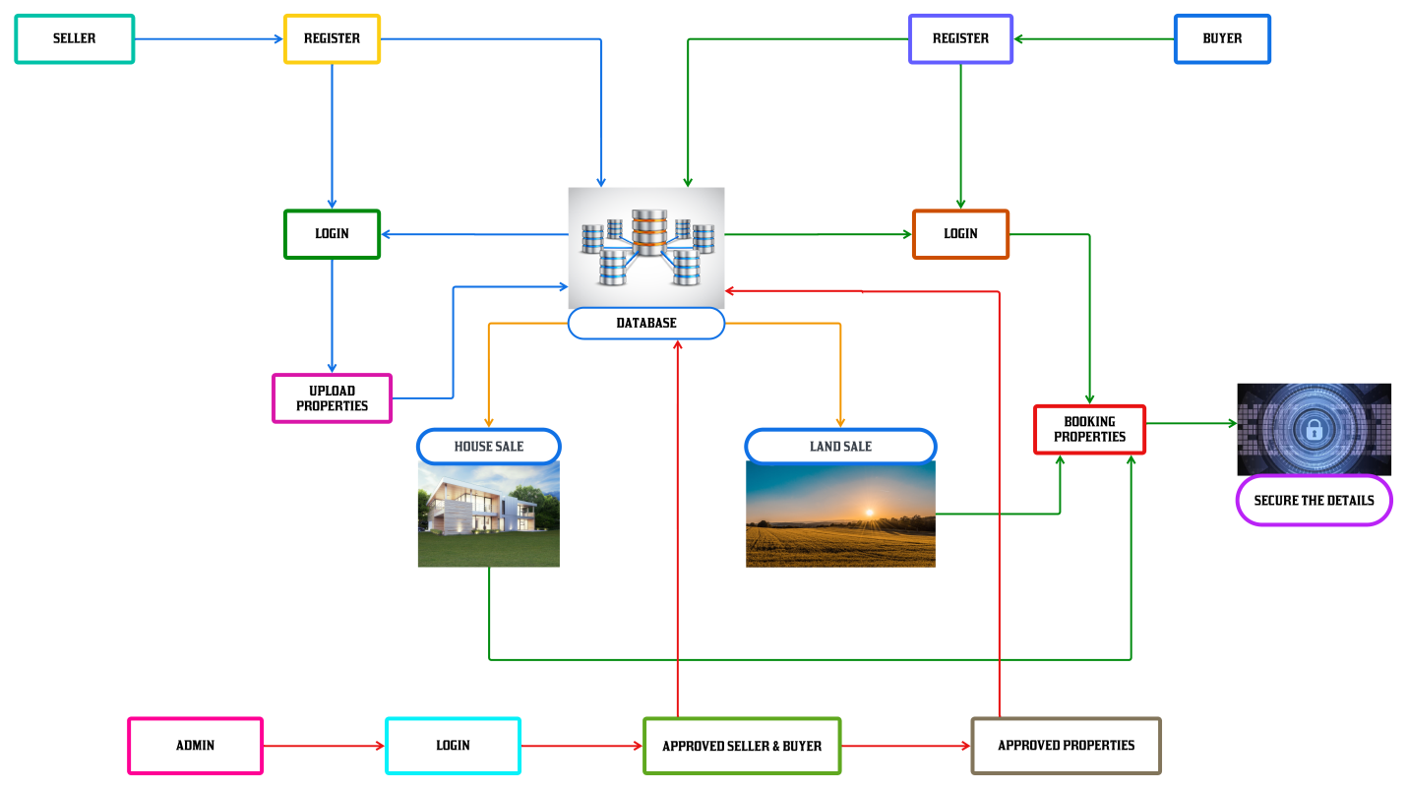
ARCHITECTURE DIAGRAM

Slide 14
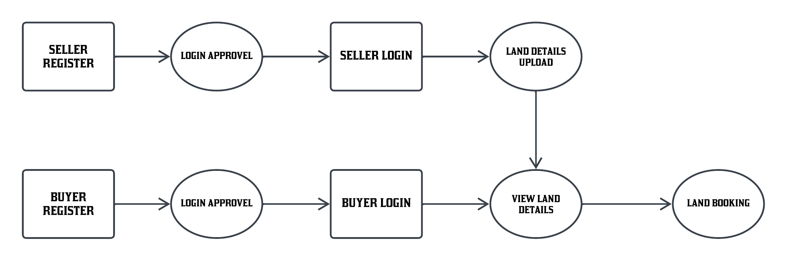
DATA FLOW DIAGRAM

Slide 15
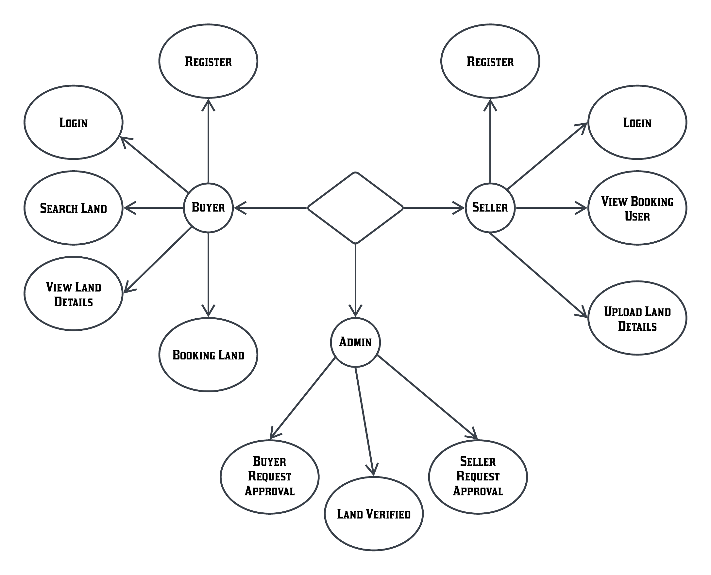
ER DIAGRAM

Slide 16
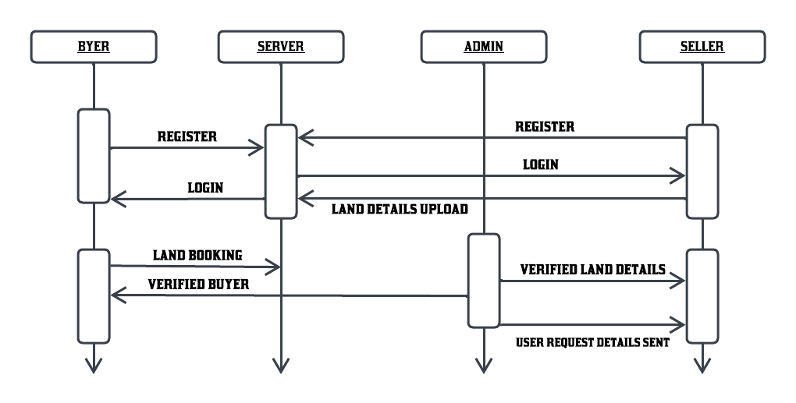
SEQUENCE DIAGRAM

Slide 17
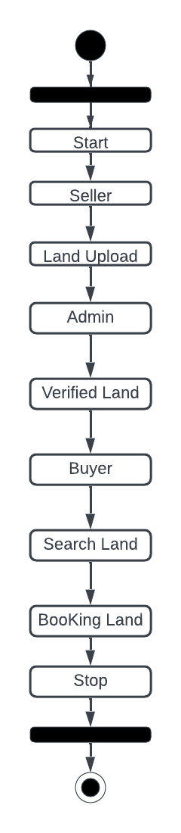
COLLABORATION DIAGRAM

Slide 18
TESTING
UNIT TESTING
INTEGRATION TESTING
FUNCTIONAL TESTING
ACCEPTANCE TESTING
SYSTEM TESTING

Slide 19
UNIT TESTING
Unit testing involves the design of test cases that validate that the internal program logic is functioning properly, and that program input produces valid outputs. All decision branches and internal code flow should be validated. It is the testing of individual software units of the application .it is done after the completion of an individual unit before integration. This is a structural testing, that relies on knowledge of its construction and is invasive. Unit tests perform basic tests at component level and test a specific business process, application, and/or system configuration. Unit tests ensure that each unique path of a business process performs accurately to the documented specifications and contains clearly defined inputs and expected results.

Slide 20
INTEGRATION TESTING
Software integration testing is the incremental integration testing of two or more integrated software components on a single platform to produce failures caused by interface defects.
The task of the integration test is to check that components or software applications, e.g. components in a software system or – one step up – software applications at the company level – interact without error.

Slide 21
FUNCTIONAL TESTING
Functional tests provide systematic demonstrations that functions tested are available as specified by the business and technical requirements, system documentation, and user manuals.
Functional testing is centered on the following items:
Valid Input : identified classes of valid input must be accepted.
Invalid Input : identified classes of invalid input must be rejected.
Functions : identified functions must be exercised.
Output : identified classes of application outputs must be exercised.
Systems/Procedures: interfacing systems or procedures must be invoked.

Slide 22
Acceptance Testing
User Acceptance Testing is a critical phase of any project and requires significant participation by the end user. It also ensures that the system meets the functional requirements.
Acceptance testing for Data Synchronization:
The Acknowledge will be received by the Sender Node after the Packets are received by the Destination Node
The Route add operation is done only when there is a Route request in need
The Status of Nodes information is done automatically in the Cache Updating process

Slide 23
SYSTEM TESTING
System testing ensures that the entire integrated software system meets requirements. It tests a configuration to ensure known and predictable results. An example of system testing is the configuration oriented system integration test.
System testing is based on process descriptions and flows, emphasizing pre-driven process links and integration points.

Slide 24
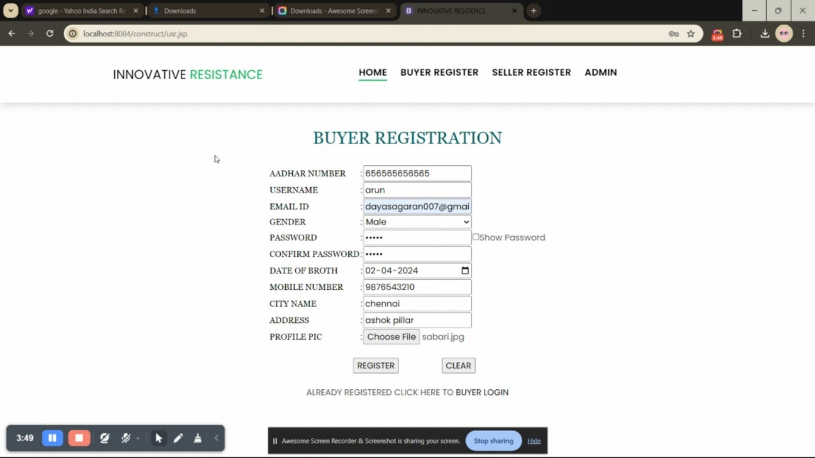
INPUT AND OUTPUT
SCREENSHOTS

Slide 25
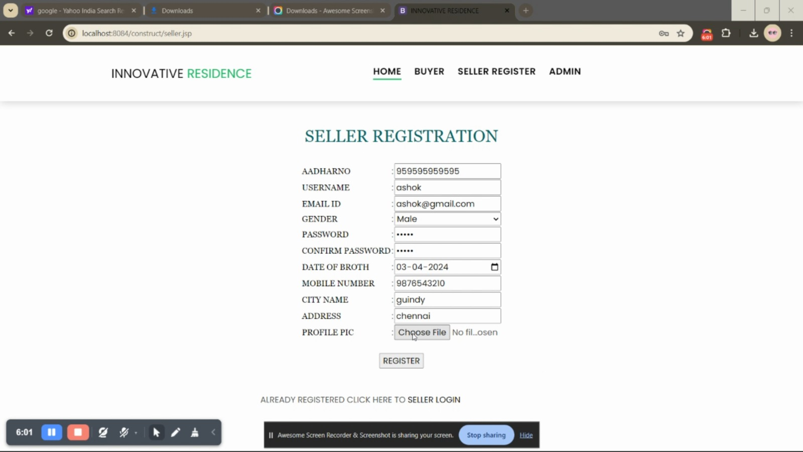

Slide 26
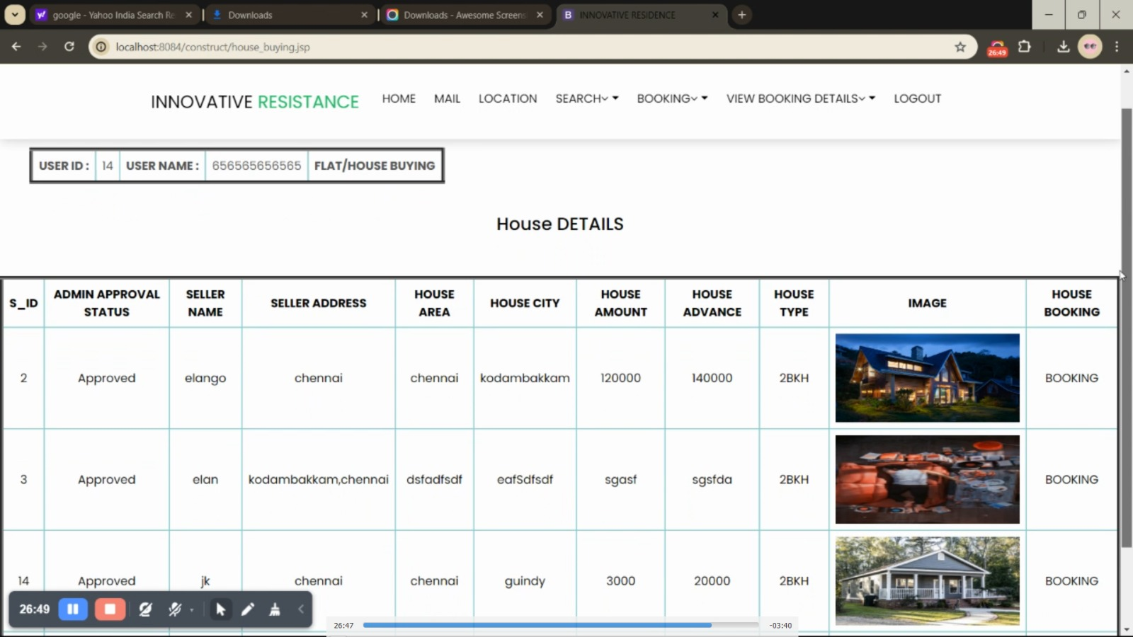

Slide 27
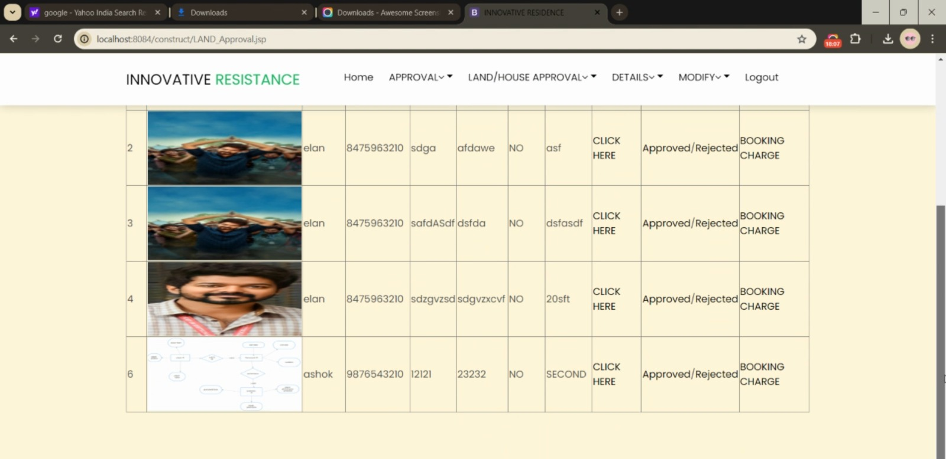

Slide 28
CONCLUSION
Innovative Resistance is one of the most secure ways of storing data without it being changed. It is a distributed ledger that is open to anyone and once data is put into it, it is very difficult to change or meddle with it. Using this property of Innovative Resistance we want to put it to use into one of the most fraudulent systems in India, the Land Registration System. Our system uses Innovative Resistance with the employment of hyper ledger. This gives rise to a system that is more evolved and features all the activities like buying and selling in an efficient and reliable way. Innovative Resistance technology made this system secure and faster. If this kind of system is upgraded further and integrated with useful API then this will lead to faster transactions and will eventually lead to easement of the entire process, thus making the entire system hassle free and convenient in the long run which would be beneficial to the mankind.

Slide 29
REFERENCES(as per IEEE format only)
[1] N.S.Tinu(2018), A Survey on Innovative Resistance Technology Taxonomy, Consensus Algorithms and Applications.
[2] J. Michael Graglia, Christopher Mellon, Innovative Resistance and Property in 2018 : At end of the Beginning.
[3] Raquel Benbunan-Fich, Arturo Castellanos(2018) Digitalization of Land Records: From Paper to Innovative Resistance.
[4] IBM, State Street Corp. Hyper ledger Fabric: A Distributed Operating System for Permissioned Innovative Resistance.
[5] Miroslav Stefanovic, Dorde Przulj, Darko Stefanovic(2018) Blockchain and Land Administration : Possible applications and limitation.
[6] Tsung-Ting Kuo, Hugo Zavaleta Rojas and Lucila OhnoMachado(2019) Comparison of blockchain platforms: a systematic revie and healthcare examples.

Slide 30
[7] Yacov Manevich, Artem Barger, and Yoav Toc, Service Discovery for Hyperledger Fabric .
[8] Yashwanth Madaka, Building a blockchain application using Hyperledger Fabric with Angular Frontend: Part-2 https://medium.com/coinmonks/building-a-blockchain-applicationusing-hyperledger-fabric-with-angular-frontend-part-2-22ef7c77f53
[9] M.-H. Guo, Z.-N. Liu, T.-J. Mu, and S.-M. Hu, ‘‘Beyond self-attention: External attention using two linear layers for visual tasks,’’ 2023, arXiv:2105.02358.
[10] Madakam, S., & Kollu, S. Blockchain Technologies FundamentalsaPerceptions, Principles, Procedures and Practices. Journal of ˆ Social and Management Sciences, 34.

Slide 31
THANK YOU

